Slide 1


GovState
freshman
EXPERIENCE
Notes:
Aim High
Scholarship Universe

Slide 2

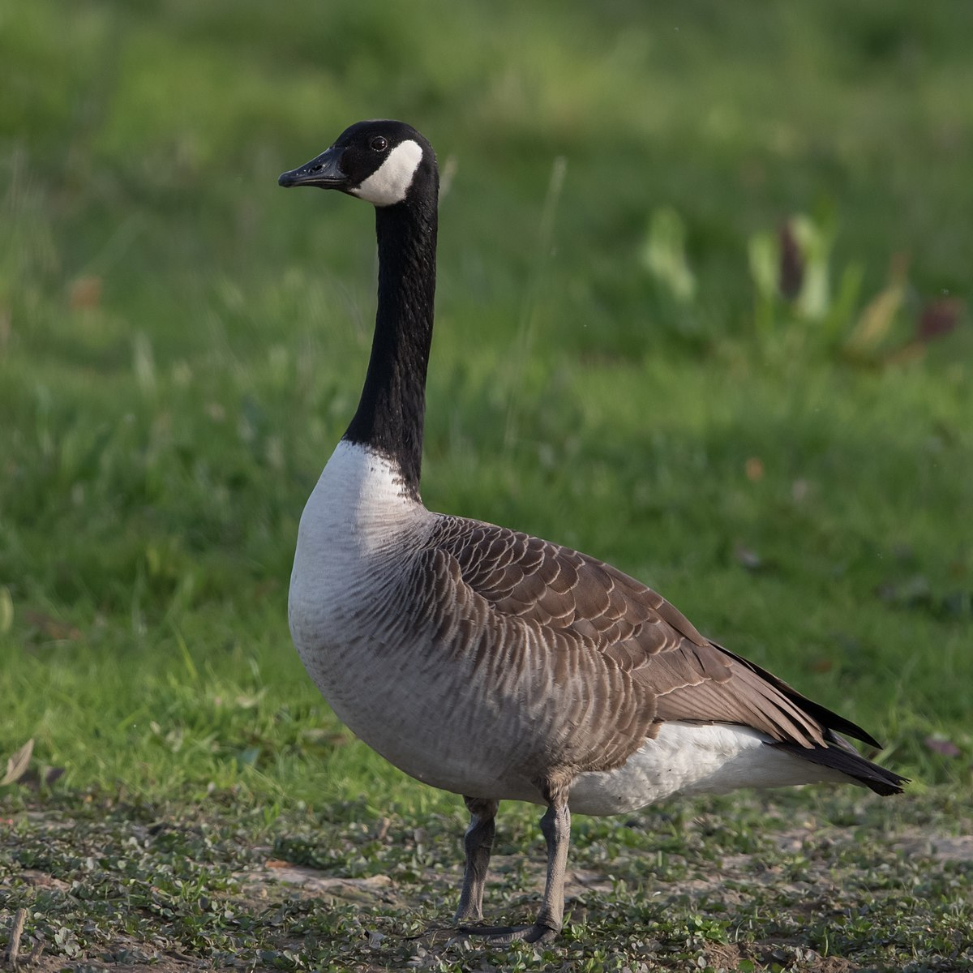
GovState Trivia
How tall is the Paul Bunyan Statue located across from Prairie Place?
25 feet
What is the most commonly seen bird on campus?
Goose
What year did GovState welcome the first class of four-year freshman?
2014

Slide 3
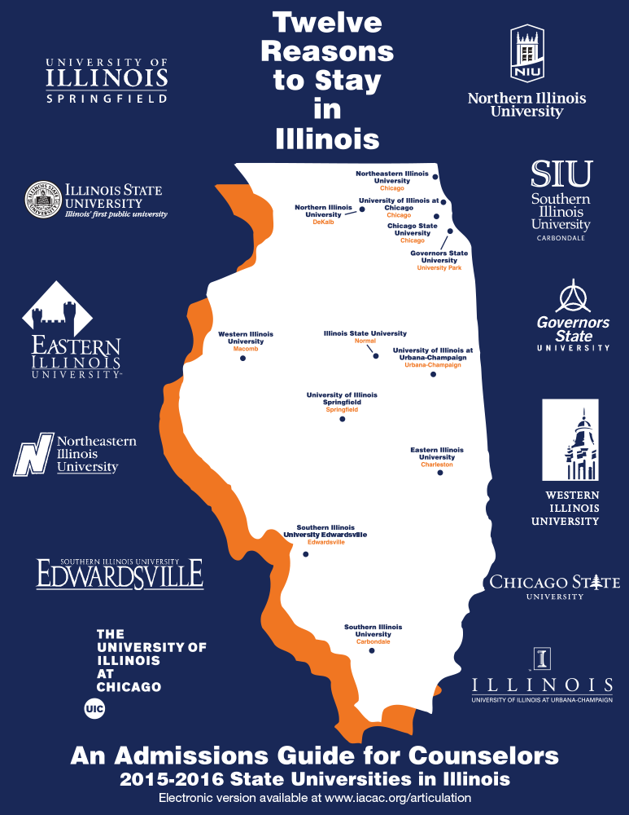
Fast Facts on GovState
4,338 students enrolled
12:1 student to faculty ratio
25 countries represented
62,000+ alumni
750-acre campus
80+ student organizations and clubs

Slide 4
Top 10 Undergraduate Majors
Accounting, BS
Nursing, BSN
Communication, BA
Community Health, BHS
Elementary Education, BA;
English, BA;
Information Technology, BS
Interdisciplinary Studies, BA
Psychology, BA
Business Administration, BA
Criminal Justice, BA
Social Work, BSW

Slide 5
What’s New @ GOVSTATE?
First Generation Center – opened in Fall 2023; support center focused on providing extra resources to succeed in their educational journey
Latinx Resource Center - opened in Spring 2024; serving Latinx students by supporting, appreciating and culturally representing on GovState’s campus
Social Justice Initiative (Legal Clinic) – opened Summer 2023; provides free self-help legal assistance and non-legal resources to low-income Illinois residents
Greek Life – Alpha Kappa Alpha Sorority, Incorporated was the first divine nine organization to cross on GovState campus in November 2023; more to come…

Slide 6

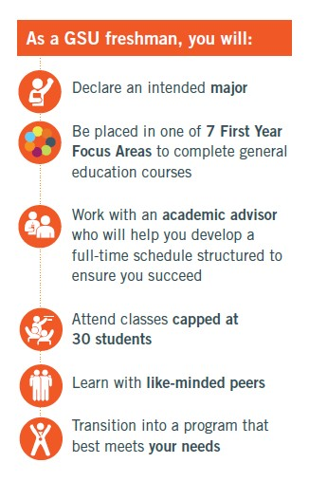
GovState’s Freshman Program
Locked-in Tuition Rate
-Guaranteed tuition rates for 12 consecutive semesters
body
15-to-Finish
-4 years to graduation!

Slide 7

7 Focus Areas of Study
DISCOVERY
Undecided? You’re not alone! About 1/3 of all Bachelors-level students change majors in the first 3 years. Explore options under guided expertise to save money and time.
EDUCATION
Secondary Education (Biology, Chemistry, Mathematics, English}, Early Childhood Education, Elementary Education
BUSINESS
Business Administration, Entrepreneurship, Health Administration, Accounting
ARTS & ENTERTAINMENT
Fine Arts, Media Studies, Theater and Performance Studies
HUMANITIES
English, History
SOCIAL & BEHAVIORAL SCIENCES
Anthropology, Sociology, Communication, Criminal Justice, Economics, Political Science, Psychology, Social Work
STEM
Biology, Chemistry, Communication Disorders, Community Health, Computer Science, Information Technology, Mathematics, Nursing

Slide 8



Get Involved!
There’s something for everyone at GovState. From Athletics and Clubs to Student Government, you can find the activity that’s right for you!
Meet new people, build a strong professional network, and get the most out of your college experience.

Slide 9
Clubs and Organizations!
Accounting, Finance, and Economics Club
Allied Health Professional Society – Alpha Eta
Alpha Iota Sigma
American Advertising Federation – GSU Chapter
American Sign Language Club
Art Forum
Association of Latin American Students
Beta Gamma Sigma, Honor Society
Black Student Union
Chess Club
Chi Sigma Iota, Honor Society
Chinese Student Association
Coalition of Occupational Therapy Advocates for Diversity
Computer Technology Club
Criminal Justice Club
Gender and Sexuality Club (GNSX)
Generating Hope
Graduate Professional Network (GPN)
GovState Bowling Club
GovState Cheer Squad
GovState Dance Company
GovState Honors Program Student Council
GovState ICA Chapter
GovState Psychology Club
GovState Supply Chain Student Club
International Business Club
International Culture Organization
Jaguars Gaming Club
Kaleidoscope
Kappa Delta Pi, Honor Society
Lambda Pi Eta-Kappa Kappa Chapter
Male Success Initiative
Master of Public Administration Club
Muslim Students’ Association
Peer Mentor Program
Phi Alpha, Honor Society
Phoenix Newspaper
Physical Therapy Student Association
Pre-Health Club
Psi Chi Psychology National Honors Society
Reconstructed
Sigma Tau Delta – Alpha Chi Psi Chapter
Soccer Club
Social Work Student Organization
Student Activities Council
Student Education Association
Student Healthcare Management Assoc.
Student Occupational Therapy Assoc.
Student Senate
Student Veterans Organization
Students of Addiction Studies Club
Sustainability Club
Table Tennis Club
Tau Sigma National, Honor Society
Trans4mation Gospel Choir
Upsilon Phi Delta, Honor Society
Wellness Club
Writers Union
Young Christian Disciples
…breakout to learn more.

Slide 10
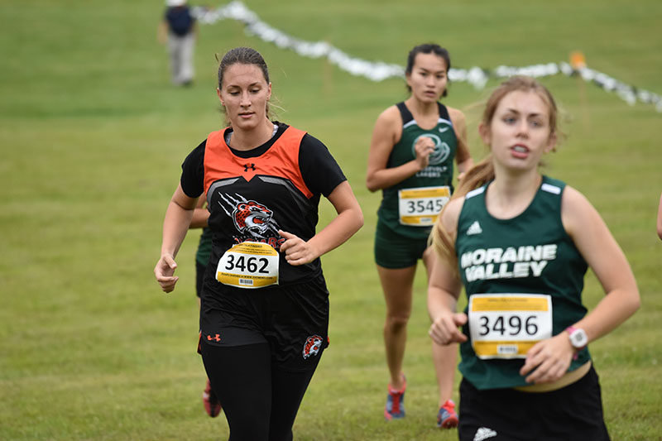



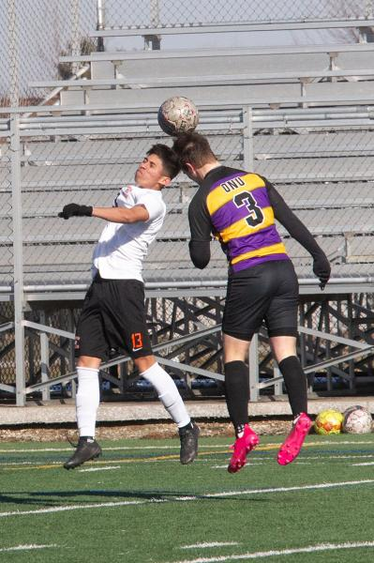
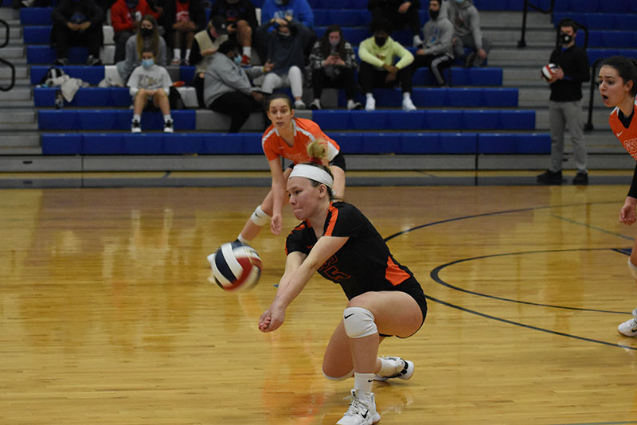
Become a Jaguar!
NAIA Collegiate Teams
Men’s and Women’s Basketball
Men’s and Women’s Cross Country & Track
Men’s and Women’s Golf
Men’s and Women’s Soccer
Women’s Volleyball
Women’s Bowling
Women’s Softball
Esports
Varsity Reserve Teams:
Men’s and Women’s Basketball
Men’s and Women’s Soccer
Women’s Volleyball

Slide 11

Guaranteed Graduate Program Admission (GPATH)
Guarantees admission into one of ten graduate programs after graduation with your bachelor’s degree
Accounting
Biology
Business Administration
Business Analytics
Chemistry
Communication Disorders
Health Informatics
Human Resources
Occupational Therapy
Physical Therapy

Slide 12
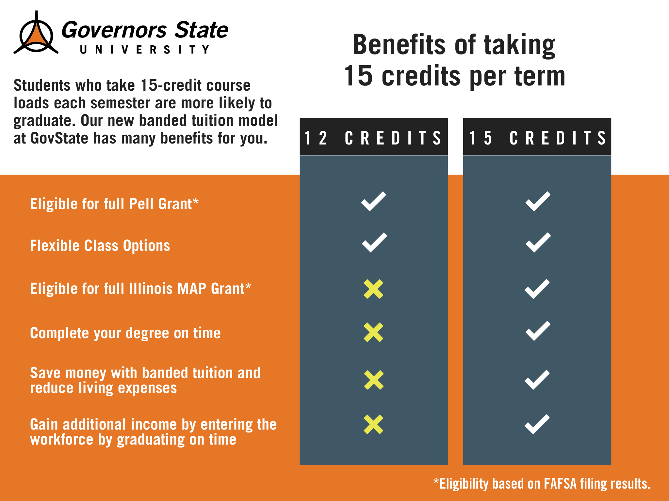
New for 24-25- Banded Tuition
All new students will be charged banded tuition started in Fall 2024.
Allows students to be charged the same tuition if you are taking 12 credit hours or more!

Slide 13
Tuition and Fees
 | GovState Cost | Financial Aid Opportunities
Non- Residential Cost | $15,650 per year* ($62,600 Degree) | Max Pell Grant: $7,395 Max Illinois MAP Grant: $8,400 Potential Refund of $145 (Fall and Spring Combined)
Residential Cost (Tuition, fees, housing, and meal plan) | $23,758 per year* ($95,032 Degree) | Remaining Cost: $7,963*

Slide 14

Financing Your Education

Slide 15
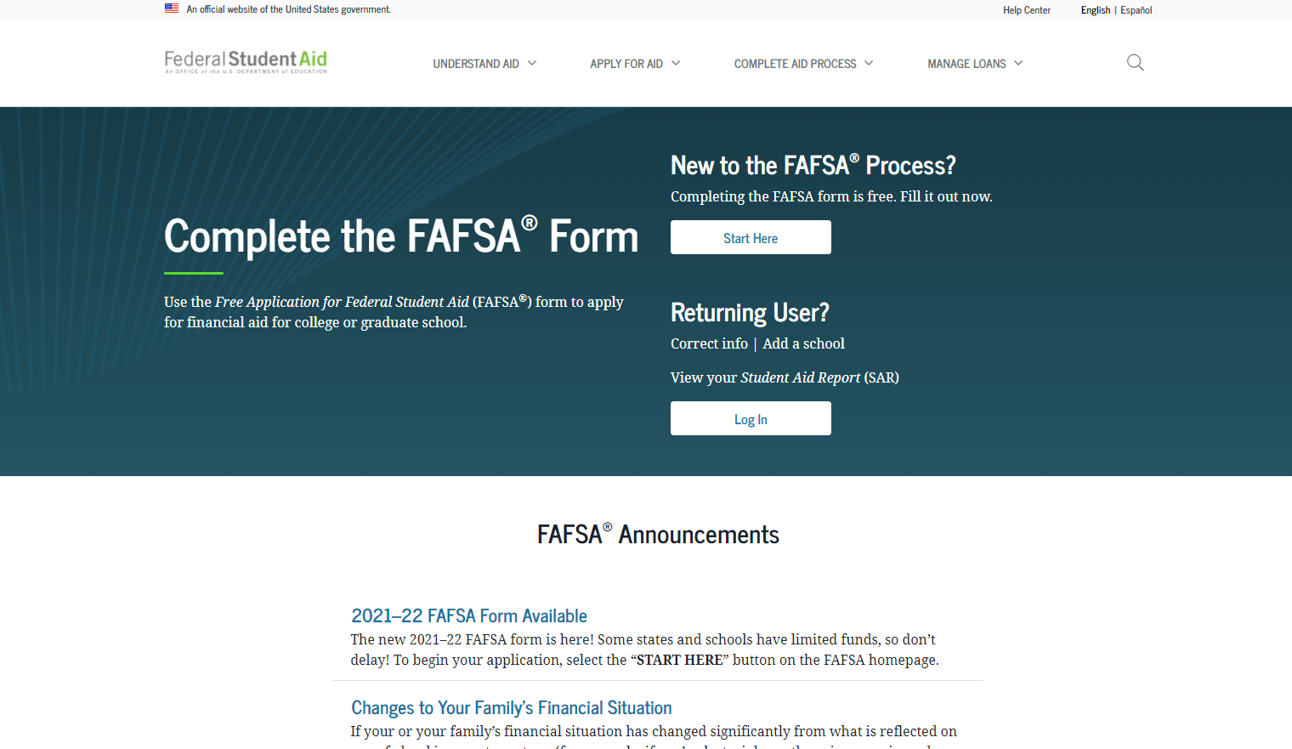
How Do I Apply for Financial Aid?
Have you done the #FAFSA?
Free Application for Federal Student Aid
Found online at studentaid.gov
Direct Link: (https://studentaid.gov/h/apply-for-aid/fafsa)
Update for 26/27 FAFSA

Slide 16

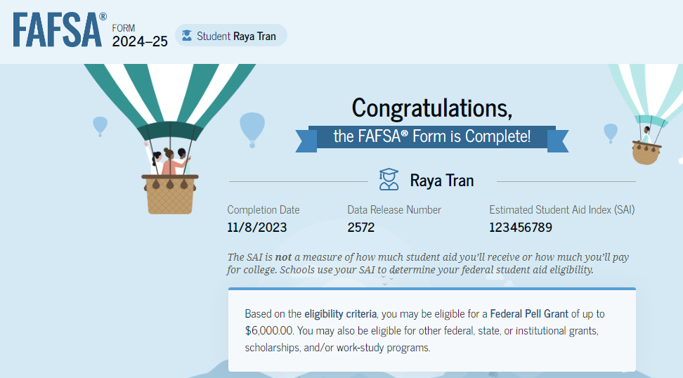
FAFSA Processing Results
Student will receive a ‘FAFSA Submission Summary’ via email
Record will be sent to colleges student listed on FAFSA about one week after FAFSA is
submitted
Colleges may request
additional information
after FAFSA received
Corrections can be made;
be wary of corrections!
Too many can lead to verification.

Slide 17

Cost of Attendance
Direct Costs- Paid directly to school
Tuition, fees, room and board, meal plans, etc.
Indirect Costs- Variable fees that depend on personal circumstances/choices. These costs can vary widely.
Transportation, personal expenses, books and supplies, off-campus housing, etc.
COA is not what you will pay out of pocket; consider it a comprehensive budget that helps you plan for all potential expenses associated with your education.

Slide 18
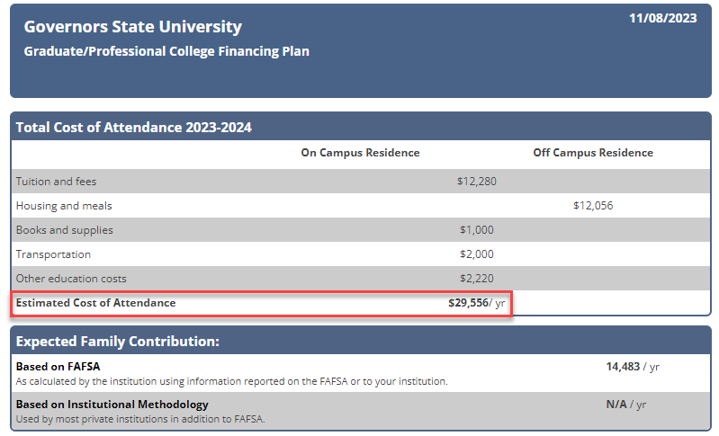
Example Cost of Attendance
However, I only took 6 classes for the year, so my out-of-pocket tuition and fees were actually $8,856.

Slide 19

Types of Financial Aid
1. Grants
2. Loans
3. Scholarships
4. Student Employment Opportunities

Slide 20

Types of Grants (2024-25 Award Amounts)
Federal PELL Grant
Up to $7,395, determined by SAI
Illinois MAP Grant
Up to $8,400, determined by SAI
Federal SEOG Grant
$1,000 for students with
exceptional need
TEACH Grant
Pays up to $3,772 p/year
Requires 3.25 GPA
After graduation 4-year work requirement

Slide 21

Student Loans
1. Federal Direct Loans*
-Subsidized
-Unsubsidized
-Parent PLUS
2. Private Student Loans
*Students must be enrolled in at least half-time (6 credit hours) status with Financial Aid eligible coursework to qualify for Federal loans.

Slide 22
Dependent Direct Loan Borrowing Limits
Grade Level | Amount
First Year | $3,500 Subsidized; $2,000 Unsubsidized
Sophomore | $4,500 Subsidized; $2,000 Unsubsidized
Junior/Senior Year | $5,500 Subsidized; $2,000 Unsubsidized
Aggregate Loan Limits | $23,000 Subsidized; $31K including Unsub
Notes:
Define difference between subsidized and unsubsidized loans
Mention there are annual loan limits (freshman year sub is $3.5K/sophomore year sub is $4.5K, etc)
Mention we offer plus loans but those are meant to bridge the gap, if a student is leaning toward one, please come talk to our office first or visit scholarship universe. Plus loans offer a higher interest rate, similar to a private loan.

Slide 23
Parent Plus Loan
A parent-plus loan is a federal student loan taken out in the parent's name. The parent is ultimately responsible for repaying the loan.
While this is better than pursuing a private loan, we recommend looking into scholarships or payment plans before going this route, as PPLs carry higher interest rates similar to those of private loans.
There aren’t aggregate limits to PPL’s and can be issued up to cost-of-attendance. Meaning if you take our COA and deduct what financial aid you are set to receive (grants, loans, scholarships, federal work-study, etc.,), that can be your total PPL amount.
If you apply and are denied, you can request an endorser, or your child can receive additional unsubsidized loan money.
Notes:
Define difference between subsidized and unsubsidized loans
Mention there are annual loan limits (freshman year sub is $3.5K/sophomore year sub is $4.5K, etc)
Mention we offer plus loans but those are meant to bridge the gap, if a student is leaning toward one, please come talk to our office first or visit scholarship universe. Plus loans offer a higher interest rate, similar to a private loan.

Slide 24

Federal Work Study
Allows students to earn money to help pay for educational expenses
Employment on or off-campus
Minimum wage or higher
Gain valuable work experience
Great networking experience
FAFSA is required
https://www.govst.edu/work-study/ https://www.govst.edu/employment-resources
Notes:
FWS is a government allotment to work on campus up to the amount on their award letter
All jobs pay $15 an hour or more
These are typically assistant-type roles (answering phones, emails, etc)
I always mention during down-time they can typically get their HW done
Gain work experience and get to explore different areas within the university
Talk about that’s how you got your job here ☺

Slide 25
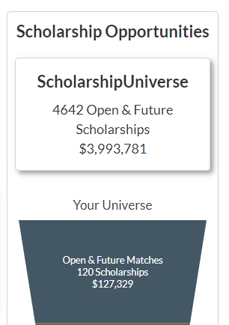
Scholarships
GSU Scholarship homepage: www.govst.edu/Scholarships/
Scholarship Universe: www.govst.scholarshipuniverse.com/public
With Scholarship Universe, Students will be able to:
Answer questions and match to scholarship opportunities they are eligible for
The more you answer, the more scholarships you match to
Easily apply online to multiple scholarship opportunities through a personalized portal
See scholarship metrics to determine their chances and effort required to apply
Be alerted whenever they are matched to new scholarship opportunities
GSU and external scholarships
All vetted = no questioning if the scholarship is legit

Slide 26
AIM HIGH – Freshman Students
Guaranteed Freshman Scholarships for up to $5000 per year
2.75- 3.49 GPA: $3,000 per year
3.5-4.0 GPA: $5,000
govst.edu/aimhigh-freshmen/

Slide 27
Presidential Scholarship
Presidential Scholarships
Up to two students receive the 2026 Freshman Presidential Scholarship. This prestigious scholarship covers the cost of tuition and fees for up to 30 credit hours each academic year (fall, spring, summer), academic year semi-suite housing in GSU’s residence hall, a Silver board plan ($2,000 per semester), and $500.00 toward books per semester at the GovState Follett Bookstore.
Provost Scholarships
Up to two students receive the 2026 Provost Scholarship. Recipients whom receive the Provost’s Scholarship can earn a $32,000 scholarship awarded at $8,000 annually.
Deans Scholarships
Up to four students receive the 2026 Deans Scholarship. Recipients whom receive the Dean’s Scholarship can earn a $28,000 scholarship awarded at $7,000 annually.
https://apply.govst.edu/register/Pres2026

Slide 28

Office of Financial Aid
Phone: (708) 534-4480
Email: faid@govst.edu
Website: www.govst.edu/financialaid
Thank You ☺

Slide 29

GovState Honors Program

Slide 30
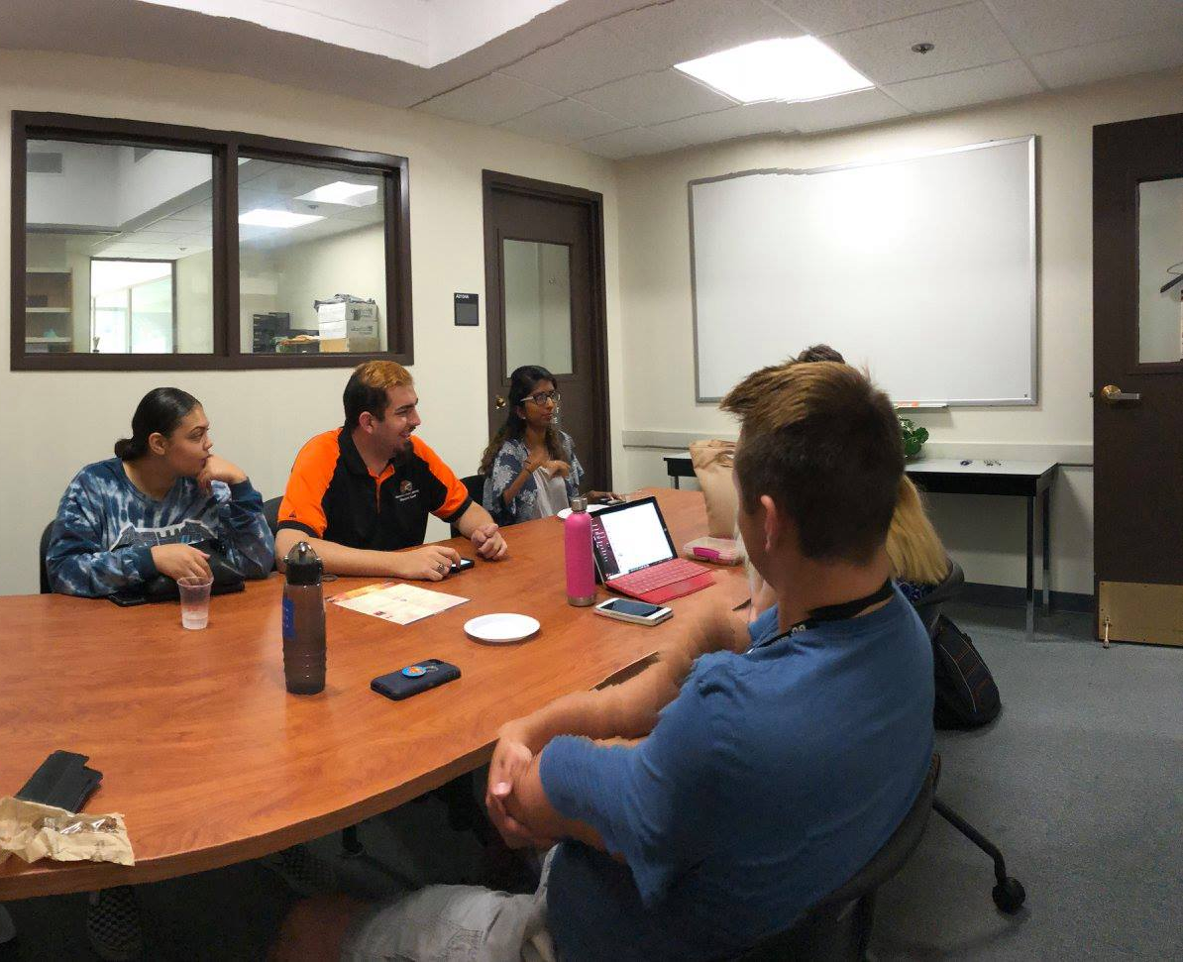
In-Class and Real-World
Honors Program Points
Curricular Activities
Courses
Independent Studies
Course Contracts
Double Majors/Minors
Co-Curricular Activities
Study Abroad
Undergraduate Research
Leadership Experiences

Slide 31

Graduate with Honors
Ready for life…Ready to lead
Honors Program Experiences
-Junior Capstone Experience
-Internship (career bound)
-Thesis (graduate school bound)
-Senior Leadership Experience

Slide 32
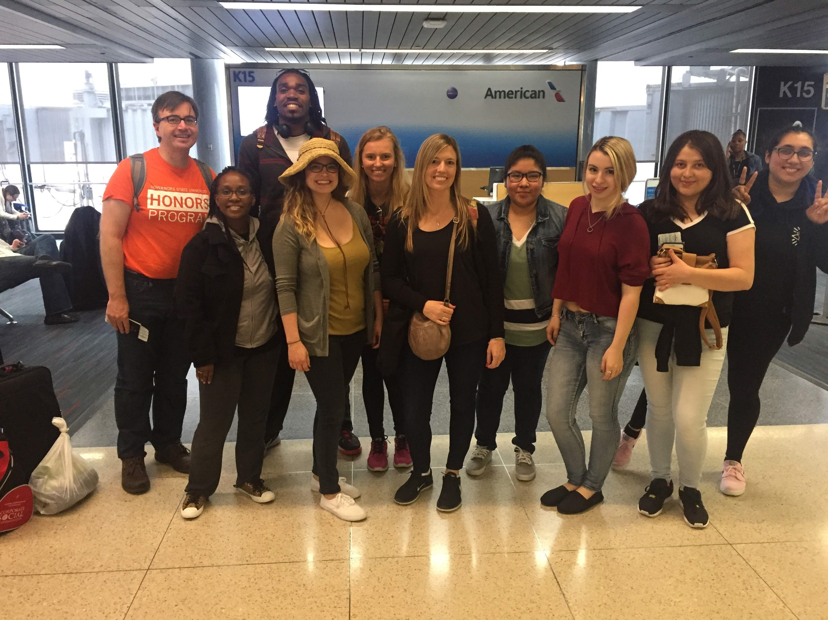
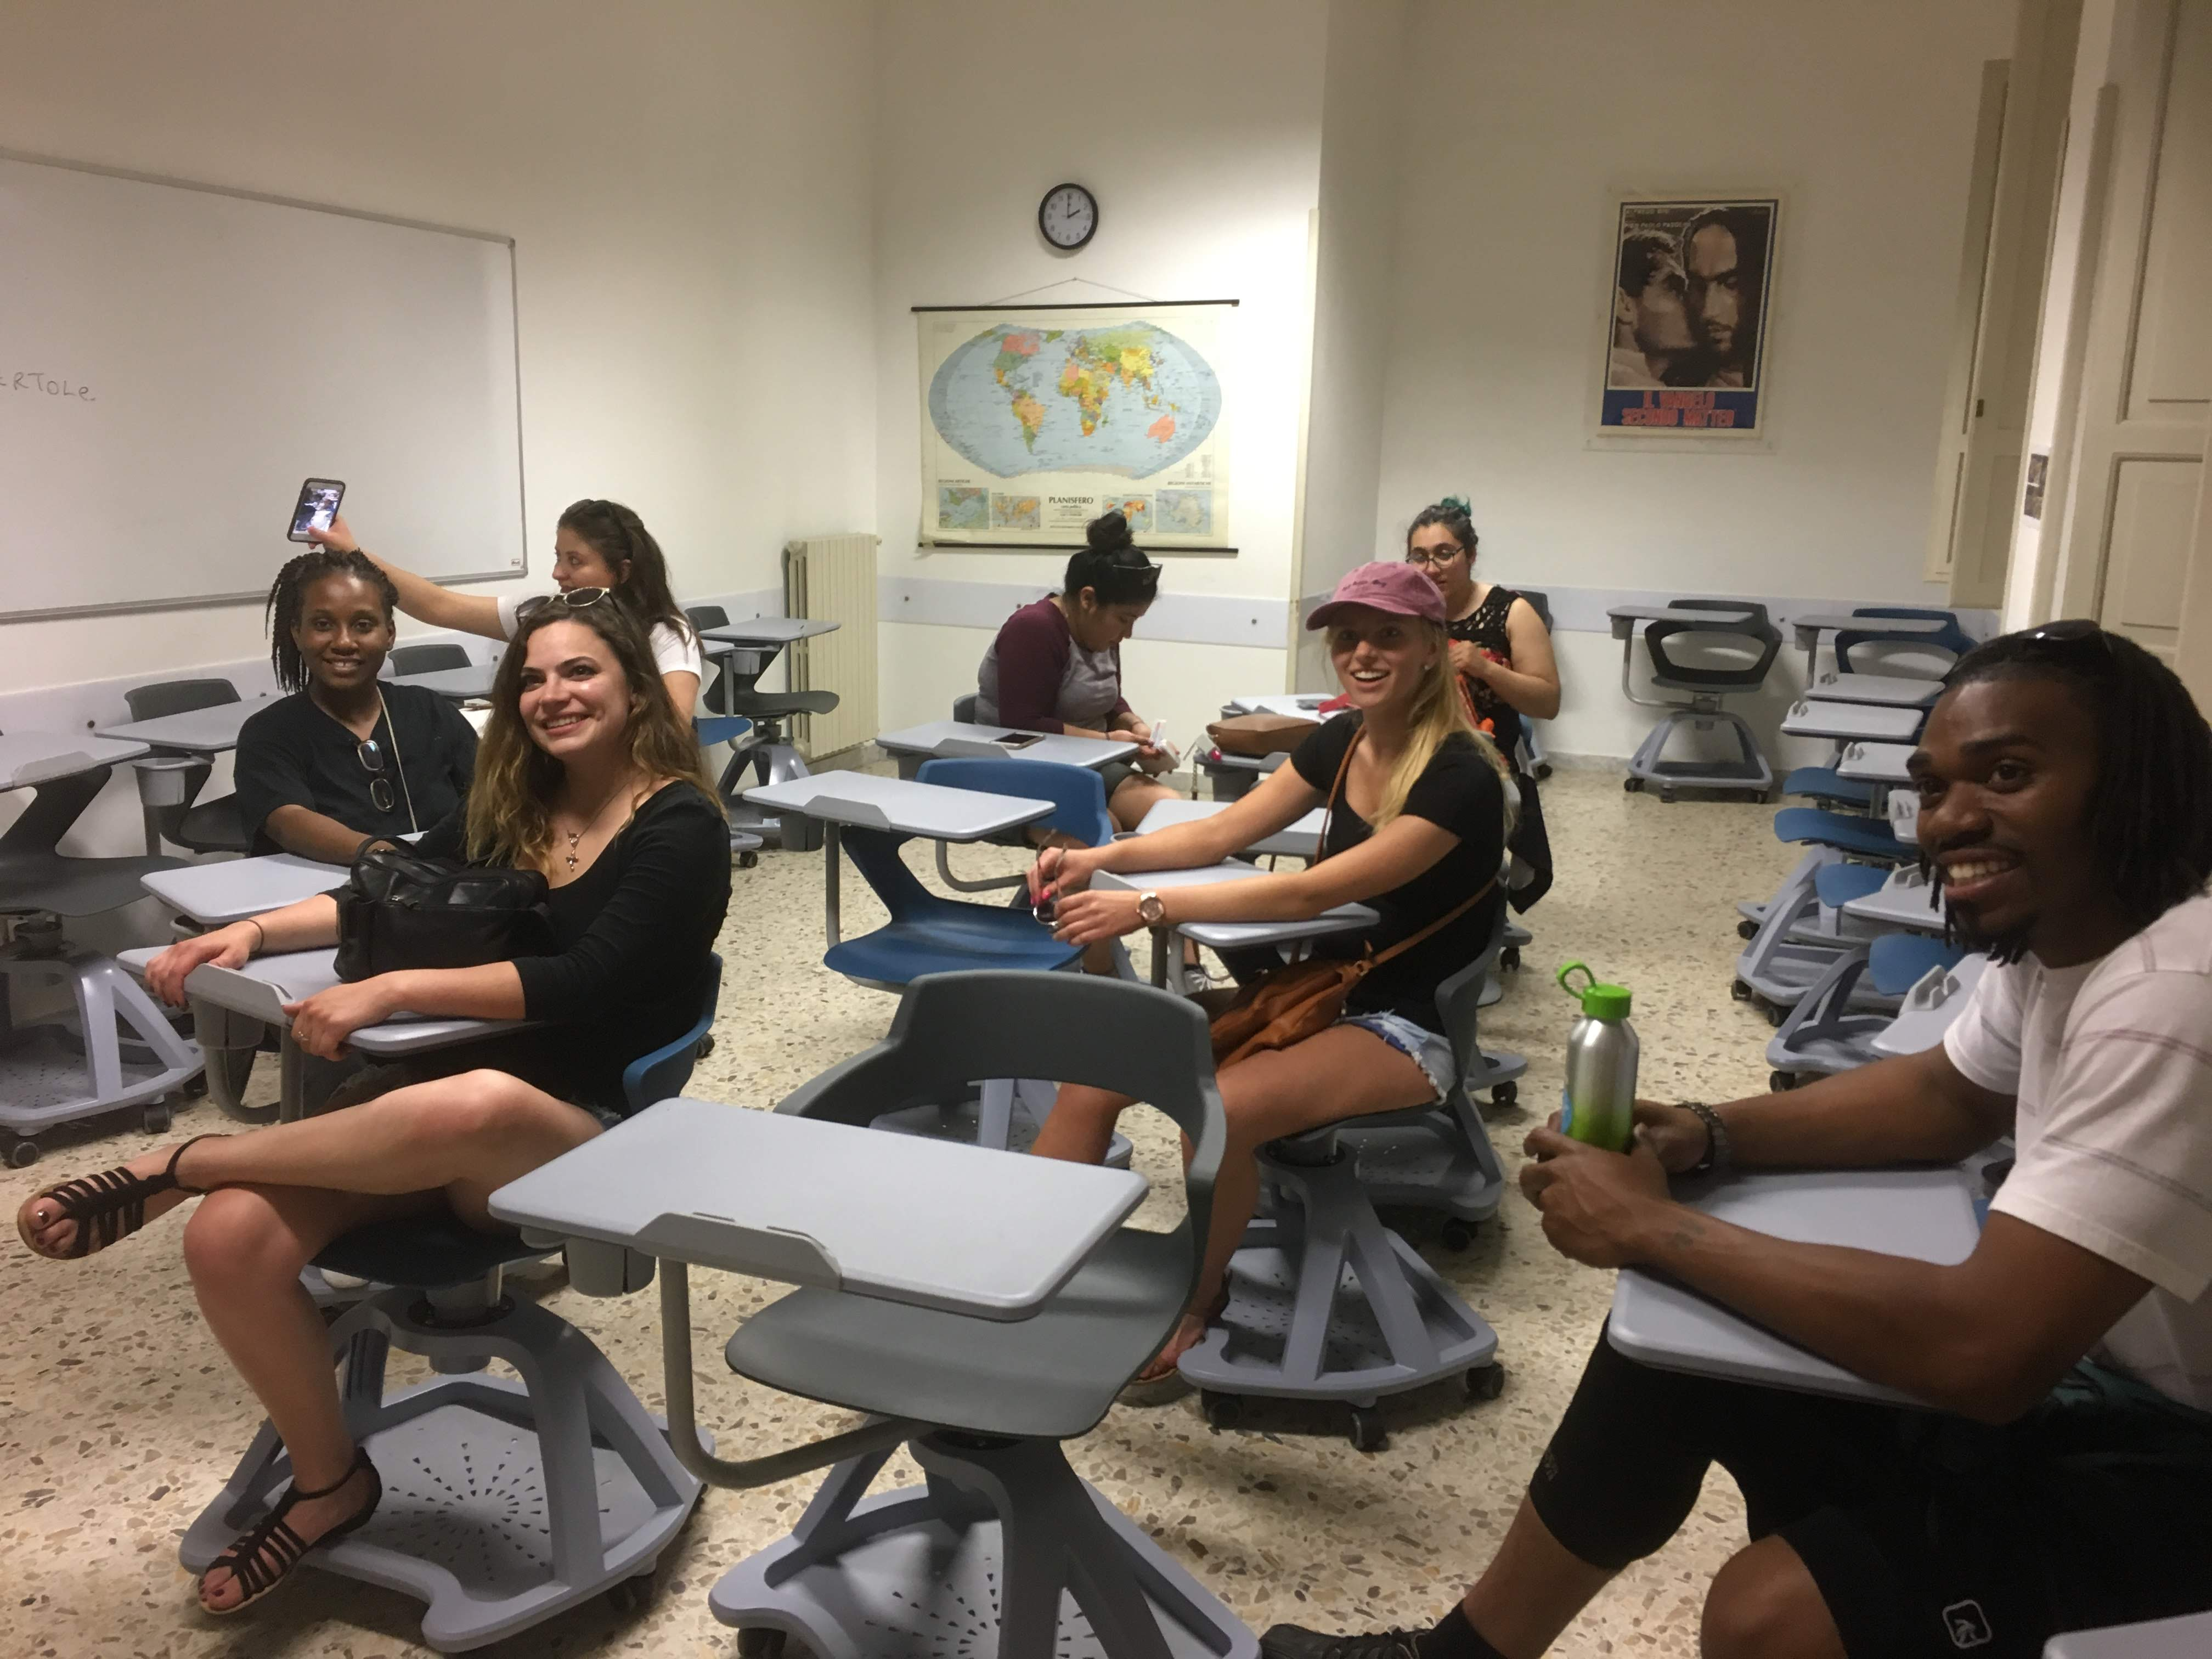
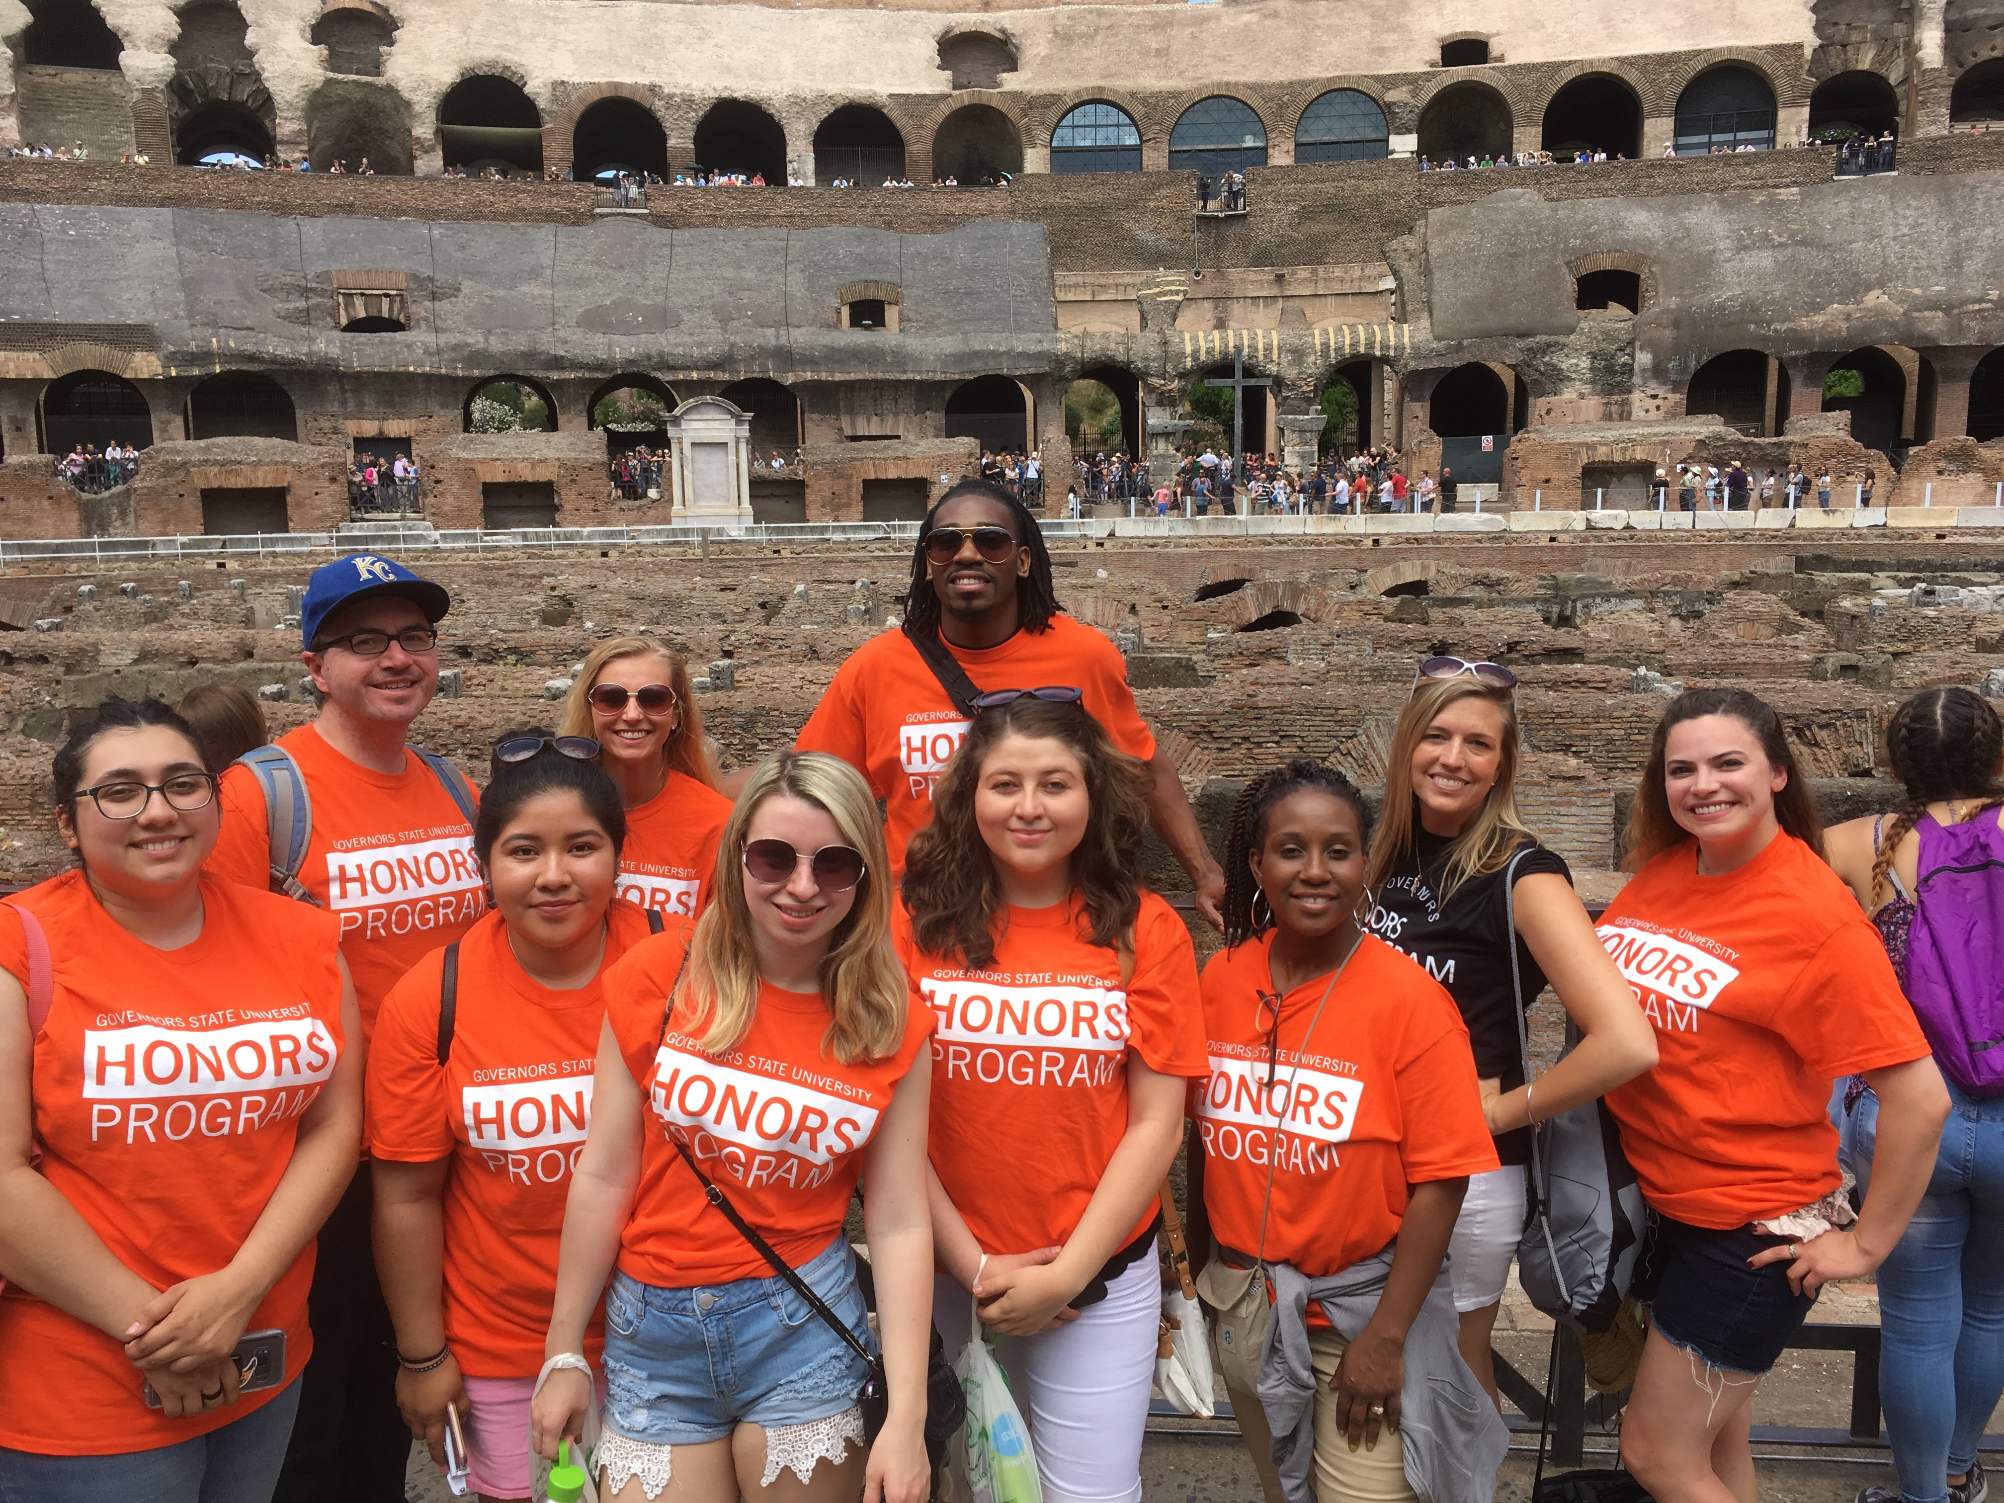
Honors Study Abroad in Rome, Italy

Slide 33
Applying to GovState

Slide 34

Freshman Admission Requirements
Minimum 2.0 unweighted GPA on a 4.0 scale
Holistic Review Process- strongly encouraged to submit supplemental information including:
Letters of Recommendation
Resume
Sports and Student Activities
ACT/SAT test scores (test optional)
Personal Statement

Slide 35


Two Ways to Apply
-
GovState Application
Complete the application for admission online at: apply.govst.edu/apply
Have official transcripts sent to apotranscripts@govst.edu
Upload supplemental documents through your application portal
OR
GovState is now on the Common App : https://www.commonapp.org/
Have your counselor upload your official transcripts through the application portal
We will use the Common App writing prompts.

Slide 36

Ways to Connect to Admissions
Direct Line: 708-534-4490
Craig Berry:
cberry@govst.edu
708-534-4492
Cynthia Gomez:
cgomez2@govst.edu
708-534-7897
Direct Link: www.govst.edu/admissions/
Spanish Language Virtual Appointments Available

Slide 37
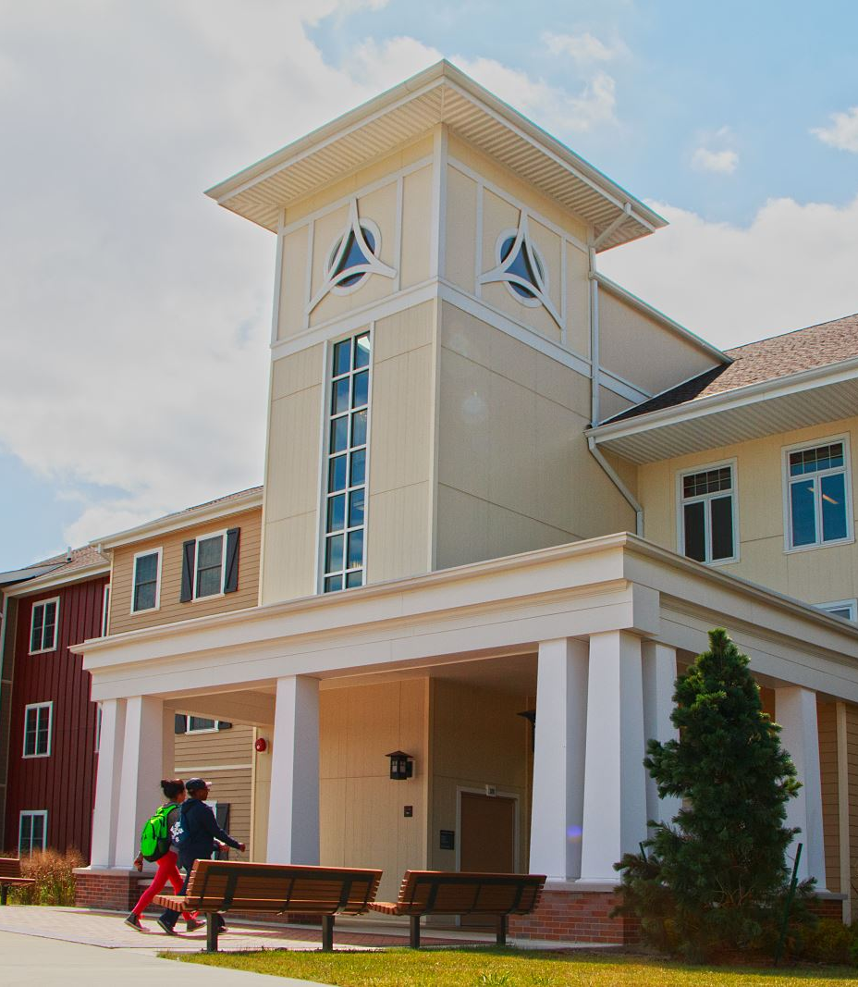
BREAKOUT SESSIONS Housing
Engbretson Hall
Campus Resources
Hall of Honors
Life on Campus (Student Life)
E-Lounge

